Slide 1
Data Visualization Project

Slide 2
Process Description:
In this project, I will explain the effect of covid-19 on the unemployment rate in our country. Many workplaces were closed due to Covid-19 and workers were removed from the workplace. Compared to previous years, unemployment increased significantly in the covid-19 period. I got some data about this from CDC numbers and DISK-AR sources. I will explain this data on the chart and transfer it to you.
For my project, I used government sources for all the data except the COVID-19 numbers. The data compiled in the Turkey seemed more complete as it was updated everyday, versus the CDC numbers and DİSK-AR which could only be updated for states that supplied the information to them.

Slide 3
Process Description:
Day by day I did my research for this topic, reviewed the data and prepared myself to prepare a report on this subject. At the moment, the unemployment issue related to the covid problem is more prominent and I have tried to present the resources I find without going beyond the unemployment issue.I started with COVID-19 data consisting of states, dates, number of cases, number of deaths, and state codes. I removed the state codes column because I considered it foreign information. I uploaded the data to GitHub. Over time, I examined and showed the number of cases and deaths by state. I wanted to investigate this data further because I had a lot of resources on this topic, so I created a calculated column showing the mortality rate by state (deaths divided by cases). I used several charts to size the cases by case count and color them by death rate. I wanted to see if this was related to the number of unemployment claims by the state. I downloaded unemployment data from the Department of Health and it seemed that jobless claims were actually higher in states that had more cases. I researched the population demographics of some states, their response to the pandemic, and the major industries that make up their economies. Then I drew my conclusions from the collected information.

Slide 4
I had a few problems finding data for my project.I had difficulty finding some of the data I wanted, because I think that due to privacy reasons, not all sites wanted to transfer the data as it is. I wanted to make sure that the data I presented was accurate, but also complete. Turkey seemed to have the most complete and up-to-date information on the COVID-19 cases and the number of deaths. The Department of Health and the News tried to show the jobless claims weekly. Unfortunately, they only have data on who applied, so it's not people who have lost their jobs, they may not have applied yet. It also does not distinguish between dismissal due to covid-19 and a seasonal worker who has been laid off or an employee who has been laid off.
The purpose of my presentation was the people of Turkey. The issues currently on everyone's mind are COVID-19 and the economy. I wanted to create a presentation that gave a brief analysis of what was going on, without any political or other bias – just facts. Hail to the health workers who are working to help people during this pandemic.

Slide 5
COVID-19 & Unemployment
After the epidemic started in Turkey, various measures came to the fore. The government did not accept a general quarantine and isolation proposal. Instead, partial quarantine and isolation measures were applied. First of all, schools and kindergartens were closed. Later, places where people gathered together (shopping mall, restaurant, cafe, etc.) were closed. Citizens over 65 and under 20 were banned from going out, and travel restrictions were imposed for those living in big cities. In addition, a curfew was imposed, usually on weekends and public holidays. These restrictions caused sluggishness in the economy and the unemployment rate increased day by day.

Slide 6
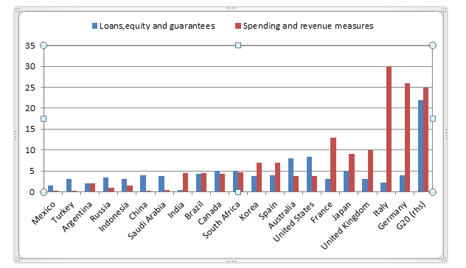
The government announced a package called the Economic Stability Shield against the effects of Covid-19 in March 2020. It was announced that the package, which was first 100 Billion TL (approximately 15 Billion US Dollars), was later increased by 250 Billion TL (36 Billion US Dollars). However, it was observed that most of this package was fictitious and consisted of loan facilities and deferrals. It is seen that the package of economic measures announced by the Government of Turkey ranks 2nd from the last among the G20 countries in terms of its ratio to GNP.

Slide 7
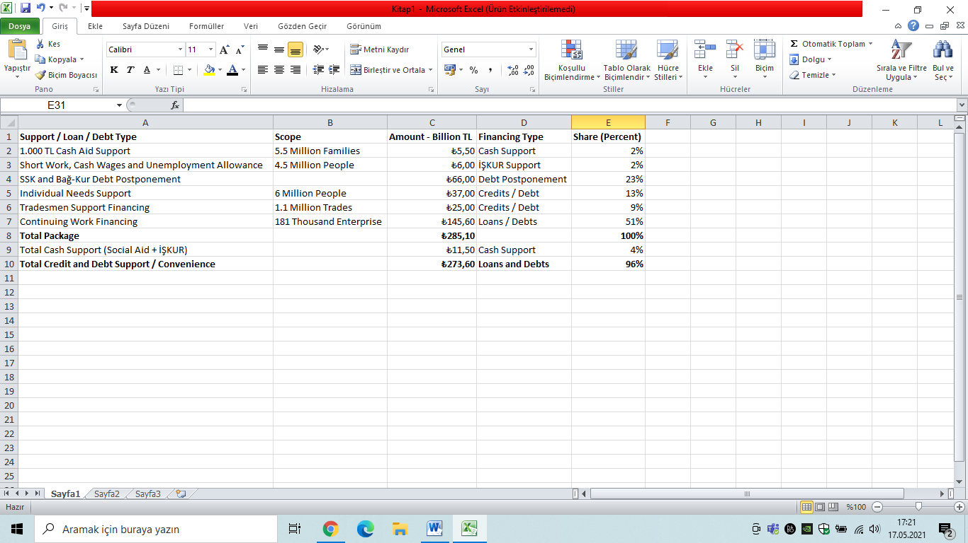
More importantly, however, is the low level of cash payments from the economic package to citizens and employees. While 96 percent of the items within the scope of the economic package announced by the government, debt postponement and credit facility, only 4 percent consists of cash support.
COVID-19 does physically affect older people at a higher rate, but younger age groups feel the financial effects. The service sector has had to lay off a lot of people due to many businesses being considered non-essential, such as salons and clothing stores. About 40% of the service sector consists of people aged 16 to 24.They are the most affected.

Slide 8
Before the epidemic, there was an economic crisis in Turkey. The February 2020 data, which do not yet reflect the effects of the epidemic, reveal that the picture in labor markets in Turkey is extremely negative. The economic crisis that started in August 2018 caused an explosion of unemployment and a serious decrease in employment in Turkey. The number of employed people, which was 29 million 318 thousand in August 2018, decreased to 26 million 753 thousand in February 2020. In Turkey, 2 million 500 thousand people lost employment between August 2018 and February 2020. While the decrease in employment continues, the number of unemployed has reached enormous dimensions. Narrowly defined number of unemployed was announced as 4 million 228 thousand in February 2020. The broad-defined number of unemployed, calculated by DİSK-AR, reached 8.5 million in February 2020. Urban youth unemployment exceeded 40 percent, and the real unemployed rate reached 24.5 percent. Youth unemployment reached its peak, and one out of every 4 young people became unemployed.

Slide 9
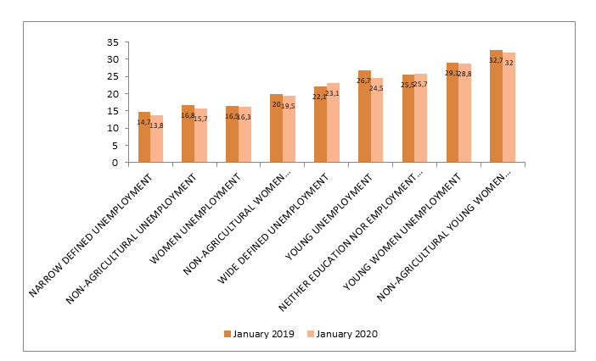
Young female unemployment and urban female unemployment continue to be seen as the highest type of unemployment in the last 1 year. In January 2020, the highest increase was seen in urban young female unemployment.
Unemployment of unemployed youth, which was not seasonally adjusted, decreased by 2.2 points to 24.5 percent in the last 1 year, and female unemployment that was not adjusted for seasonal effect decreased by 0.2 points to 16.3 percent.

Slide 10
During the crisis, urban young women unemployment reached 36 percent, saw the highest level of unemployment in the women's unemployment category. In January 2020, urban youth unemployment was again the highest type of unemployment.
There is a general decrease in unemployment types in January 2020 compared to January 2019, when the impact of the economic crisis was seen the most. However, the increase in the number of young people who are neither in education nor in employment (NEET) continues. In January 2020, the NEET rate increased by 0.2 points compared to January 2019 and reached 25.7 percent.

Slide 11
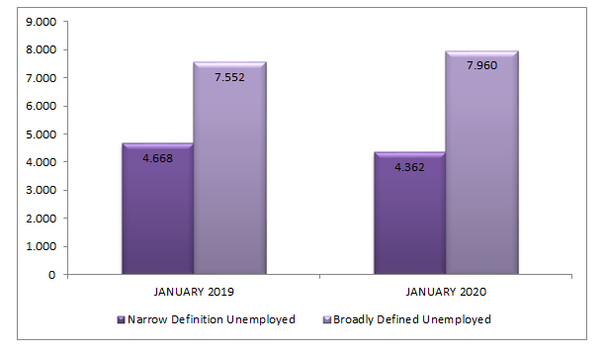
While the number of broadly defined unemployed people calculated by DİSK-AR was 7 million 552 thousand in January 2019, it reached 7 million 960 thousand people with an increase of 408 thousand in January 2020. Broaḑ defined unemployment rate was calculated as 23.1 percent in January 2020. While narrow unemployment is decreasing, one of the reasons for the increase in broad unemployment can be shown as the remarkable increase of those who are not looking for a job but are ready to work during the crisis period. The unemployed, who lost their hope as a result of long-term unemployment during the crisis period, increased by 53 percent in the last 1 year.

Slide 12
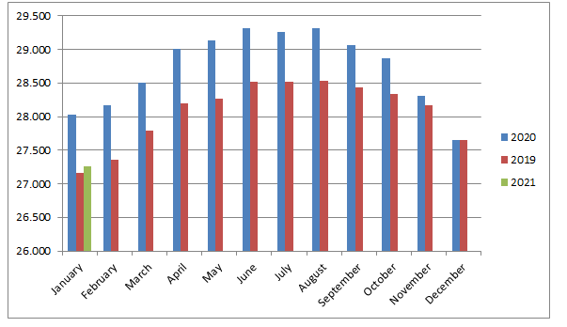
Unseasonably-adjusted employment, which was 28 million 29 thousand in January 2020, rose to 29 thousand 318 in August 2020, when the crisis started. Although the number of employed people, which showed a steady decrease from August 2020 to February 2019, showed an increasing trend in February 2019, it started to decrease again after July 2019. The number of people employed in January 2021 has decreased by 2 million 52 thousand to 27 million 266 thousand since August 2020, when the crisis started.

Slide 13
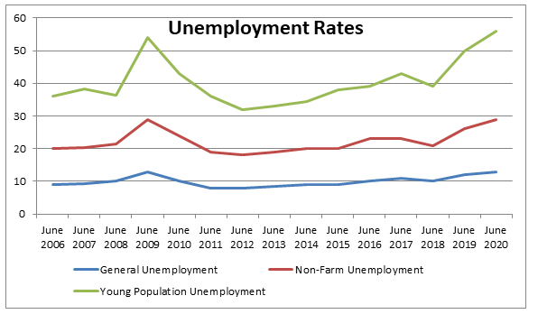
Unemployment levels in 3 different categories appear together with the figures. The table above examined the month of June. Unemployment levels from June 2006 to June 2008 follow each other. However, there is an increase in the unemployment level in June 2009. In the following years, the unemployment level both increased and decreased. In June 2019 and 2020, the unemployment level gradually increased due to the corona. The fastest increase is seen in these years.

Slide 14
Story About Covid-19 and Unemployment
Everything was fine in the world. Everything was as it was. One day, while watching the news, we got the news that the corona virus has surrounded our world. Suddenly the schools were on holiday, a few businesses were closed, restrictions were imposed, and bans surrounded us. We had a doctor relative. He lives in Aksaray with his family. He was working in a private hospital in Konya. When the number of cases increased in Aksaray, they called him to Aksaray. They had transferred the man to the corona department in the hospital in Aksaray. Although the first cases were beginning to emerge, many distressed patients were coming to the hospital with suspicion of corona. He was working very hard. He spent many months doing shifts without permission. When the number of cases started to decrease in Aksaray, Doctor Mehmet went back to Konya where he was working before and he lost his job. There were very few patients to be cared for, so many nurses and doctors across the city had lost their jobs or were on unpaid leave.

Slide 15
In May, when the epidemic was at its peak in Konya, the private health sector laid off approximately one and a half million employees. With the onset of the epidemic, hospitals had to cancel all non-urgent surgeries to make room for corona virus patients. Doctor Mehmet had a hard time under these conditions. After a while, he stopped meeting his family's needs. He had desperately returned home from many hospitals he had gone to in hopes of finding a job. No hospital hired workers. He had been unemployed for a year and a half. Now, some restrictions have decreased and we have entered a period of normalization. Doctor Mehmet had finally found a job in a private hospital.

